Slide 1
Competitive Analysis: Portfolios
Laura Jourdain - A97501469

Slide 2
M6Replay Layout: 3D screenshots 01/15/2012 URL: http://www.m6replay.fr/#/choisir-par-genre
 | Criticism | What’s good | Something better or new
Brand | Brand for adult whereas there are also TV shows for child | - Interesting logo: represents exactly the brand’s name with the 2 parts M6 and replay Fun and diverting: We can see again our favorite TV show The colors of the logo are the same as the website atmosphere | Create a logo more attractive for child
Functionality |  | Not too much information: just one main page with the principal information 2 different ways to choose his TV show (gallery or menu bar) Icon ‘mon guide’ on left corner at the top is a good way to receive information in our e-mail box
Interactivity | Missing a search bar | When we are passing the mouse on one specific TV show, the others become cloudy and the good one has his title growing up Menu bar interactive: change of color Transitions are good | Create a search bar
Navigation | When we are selecting a special TV show we can’t see where we are on the web site and how many TV show there are (Problem of hierarchy) | -fluent | Create a bottom ‘come back’ in order to arrive on the previous page

Slide 3
Kodak Layout: Three boxes 01/15/2012 URL: http://www.kodak.com/ek/US/en/Home.htm
 | Criticism | What’s good | Something better or new
Brand | No real logo, just the name and the yellow and red color Classical design | -Both for professional and amateur | more pictures
Functionality | No return bottom It is a site with details but we can’t see the differences between important and superficial information | We can choose between different languages A lot of information but with a good organization (menu bar, pictures…) | -There is a lot of information, so need menu bottom in order to come back quickly to the main page (I found it, it’s Kodak bottom but not clear)
Interactivity | - We don’t know really where we are in the website | Search bar When we are navigating the links change of color or are underlined | - Missing some interactive things
Navigation | - No return button | - More or less fluent | -There is a lot of information, so need menu button in order to come back quickly to the main page

Slide 4
Apple Layout: Five boxes 01/15/2012 URL: http://www.apple.com/
 | Criticism | What’s good | Something better or new
Brand |  | -Modern Fun Pleasant Good logo
Functionality | -We have to click on a section of the main menu bar to see the sub-element | Fluency A lot of information but very good organization in some boxes We can delimitate the different information
Interactivity |  | Good transition Many pictures that illustrate the text New design
Navigation |  | We can see where we are and it’s easy to come back thanks to the menu bar on the top of each page. Search bar

Slide 5
Abercrombie Layout: Five boxes 01/15/2012 URL: http://www.abercrombie.com
 | Criticism | What’s good | Something better or new
Brand | Simple logo (no shape just text) Dark color | -Classic -In order -For adult and child | - Brightness
Functionality |  | Main page: current affairs Information are separated with boxes -We can have an account -Thinks are easy to find -Track my order
Interactivity |  | -Good interactivity to see and order clothes: utilization of zoom and different views | - It could be cool to create automatic moving view for each clothe (no click) with trim tab speed
Navigation |  | Search bar -We know where we are: vertical menu on the right and color link Easy to come back: menu bar at the top of each page Easy to find a store

Slide 6
YvesSaintLaurent Layout: Advanced grid 01/15/2012 URL: http://www.ysl.com/en_US
 | Criticism | What’s good | Something better or new
Brand | -May be missing some personality -Classic | Elegance Interesting logo: good shape and design
Functionality |  | We can change the language We can create an account Gallery with zoom an different view Filter by one or more colors | - Create a filter by price
Interactivity |  | Control easy to understand: when we are passing with the mouse pictures are cloudy and the name of each section appears Menu bar interactive: change of color
Navigation | - No back button | We know exactly where we are: complete pathway written Pull down menu | - Create back button

Slide 7
H&M Layout: Advanced grid 01/17/2012 URL: http://www.hm.com/us/
 | Criticism | What’s good | Something better or new
Brand | We don’t really know that logo is for clothes Too simple | Fashion Mode Fun For child, women and men
Functionality | - No search bar but in each main page (for men, women and child) we can search by style of clothes thanks to the different box with pictures | We can have an account Different language | - Serach bar
Interactivity |  | Dressing room: we can see every clothes, with different views, colors… On the pull down menu when we are passing the mouse, the text is being underlined Video: multimodal data
Navigation | - We don’t know exactly where we are in the website: pathway missing | Navigation easy in general: pull down menu on each page, bottom back. Easy to find what we want to see | - Create a pathway in order to know where we are on the web site

Slide 8
Volkswagen of America Layout: Five boxes 01/17/2012 URL: http://www.vw.com/en.html
 | Criticism | What’s good | Something better or new
Brand | Missing some personality: classic, straight | -Good logo: we know it is a brand for car
Functionality |  | When you go in “models” we can choose what type of car do you want, just moving some cursors We can have an account
Interactivity | - Simple design: see the page “contact us” | We can build our project: choose the type, the color… We know where we are on the different steps Interactive pictures and gallery Cursors bar to choose our model | - Page “contact us” for instance: create boxes and more interactivity with pictures
Navigation | - No back button | We know where we are in the website (pathway) Search bar | -Create back button

Slide 9
Zara Layout: Featured photo 01/17/2012 http://www.zara.com/webapp/wcs/stores/servlet/home/us/en/zara-us-W2011-s
 | Criticism | What’s good | Something better or new
Brand |  | Clothes Simple logo Easy to remember: 2 syllables | - Need more color
Functionality |  | Shopping guide (left top corner): some videos to know how buy clothes on line or return something. Create an account and shopping bag Find store very quickly with a online map
Interactivity | - Interactivity to see the clothe in different view is slow and not very dynamic - Too classic, simple: missing some attractiveness |  | -Something moving when we are passing the mouse to move the different view of a clothe (instead of click)
Navigation |  | Search bar Easy to find what we want We can do a research by characteristics, color, size and price (just check) We know where we are (pathway)

Slide 10
Musée D’orsay : home 01/17/2012 URL: http://www.musee-orsay.fr/en/home.html
 | Criticism | What’s good | Something better or new
Brand |  | Authentic logo We know it’s a museum Elegance
Functionality | - No back button | Choose your language Very easy to find essential things like hours, events, price… 3 different colors for 3 different categories
Interactivity |  | 3 small different galleries Videos gallery Calendar to find any Interactive plan of the museum
Navigation | - When we ara navigating we can be lost due to lots of information | Search bar Home page very good | - Review the architecture after the home page: lot of information

Slide 11
Montblanc 01/17/2012 URL: http://www.montblanc.com/flash/#
 | Criticism | What’s good | Something better or new
Brand |  | Color of the logo in ad equation with the brand elegance
Functionality | Lot of details We have to click on ‘shop online’ which is another website to reach to the main page | - One can create an account - Appl “narrow your choice”: if we have a clear idea = good job for us
Interactivity |  | Moving background interesting Music: on /off function 3D feeling Different views of prodcuts | - Improve the interactivity to see the different views: we have to click on there to see and not just pass our mouse
Navigation | - No back buttom | Search bar Pathway

Slide 12
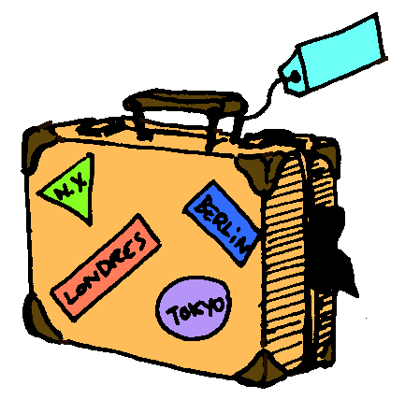
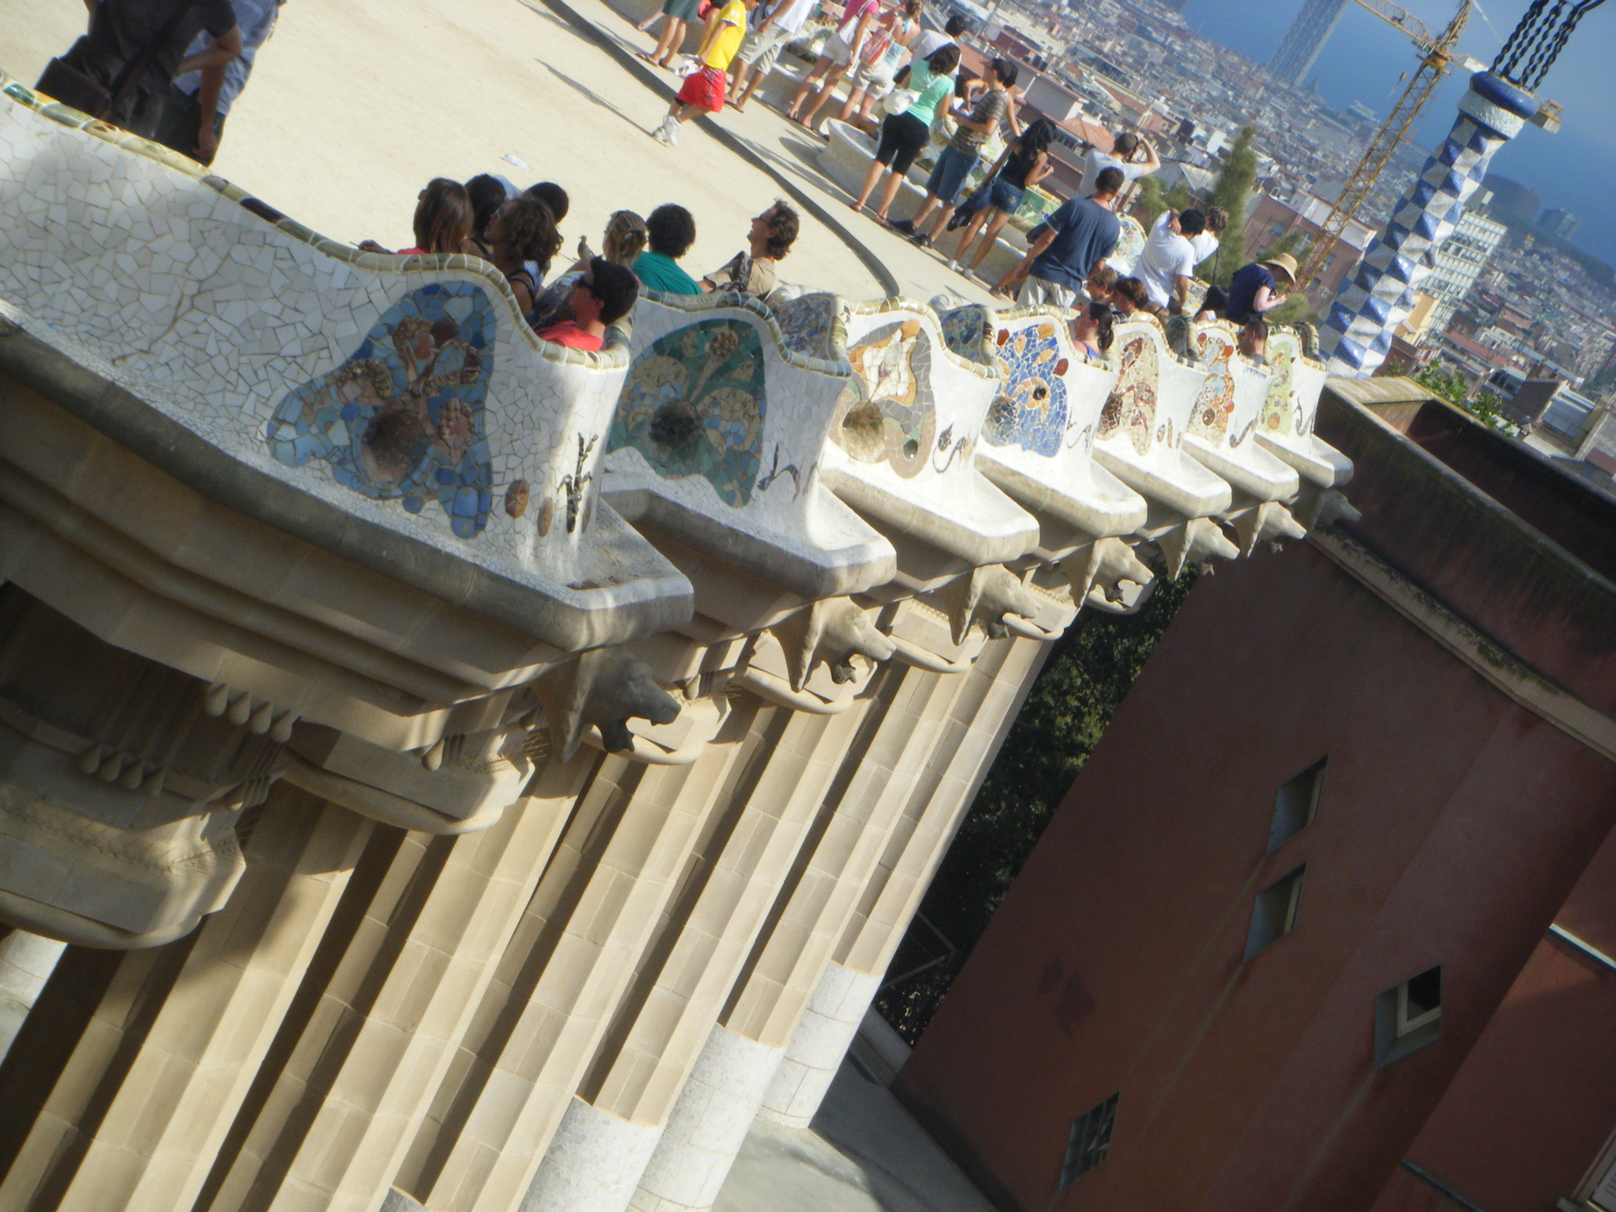
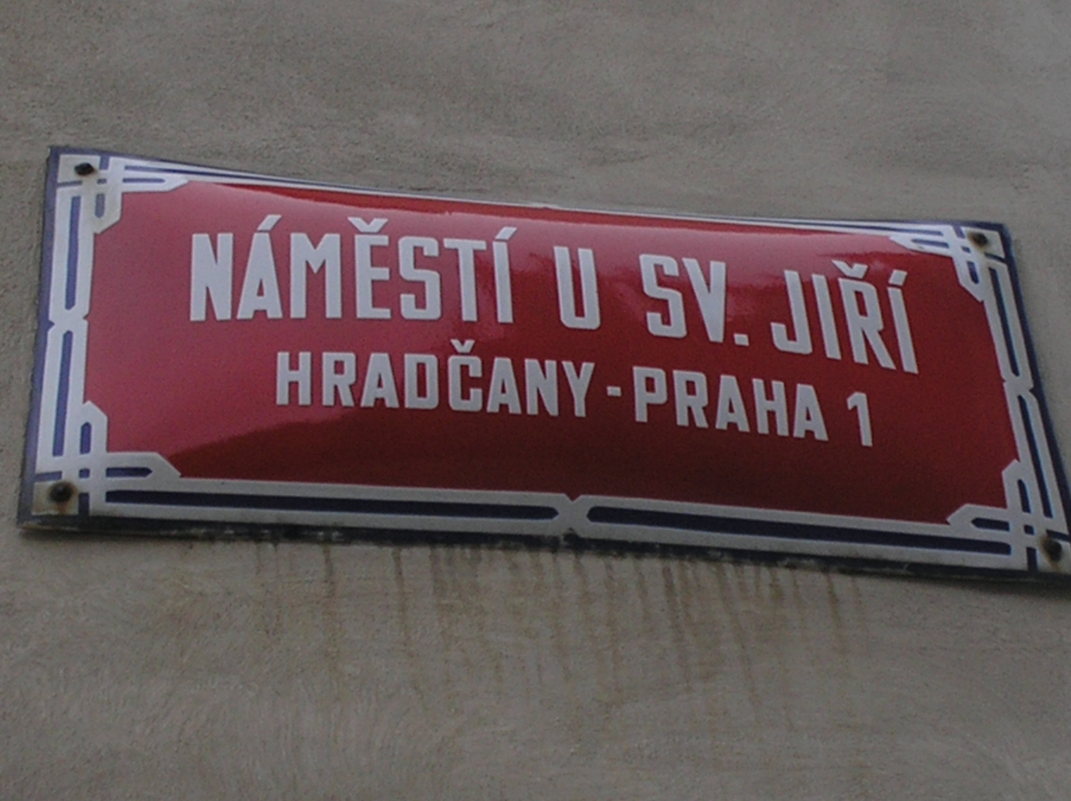
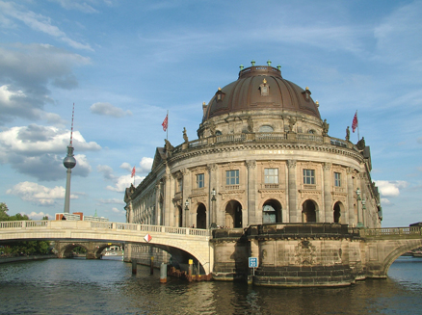
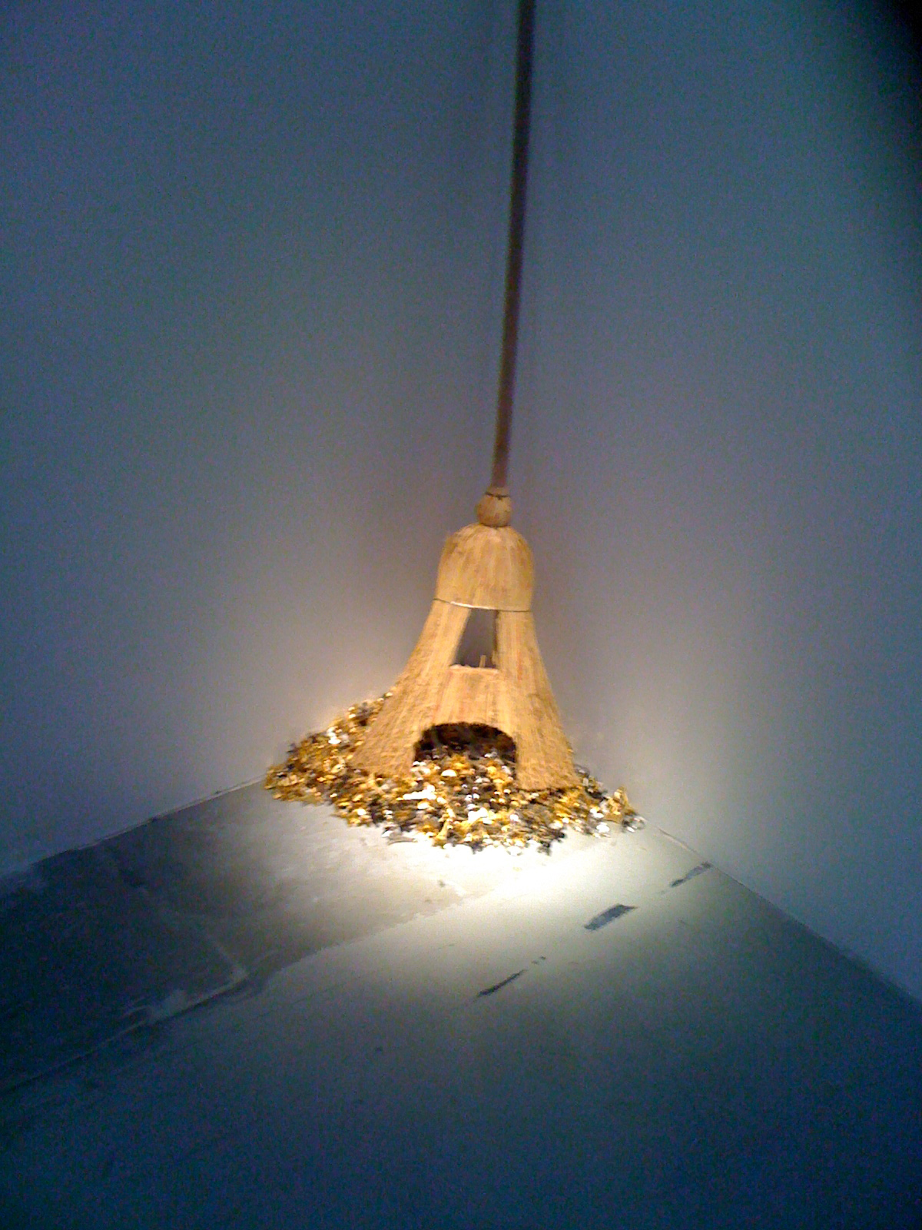
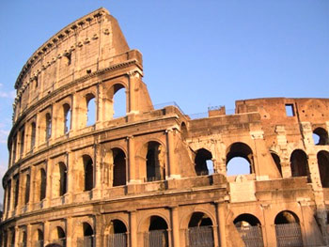
Travel in
Europe
Local cuisine Go out Movie / Music
1 of 7
Site Map Contact Us About Europe Blabla Home page

Slide 13
